Slide 1
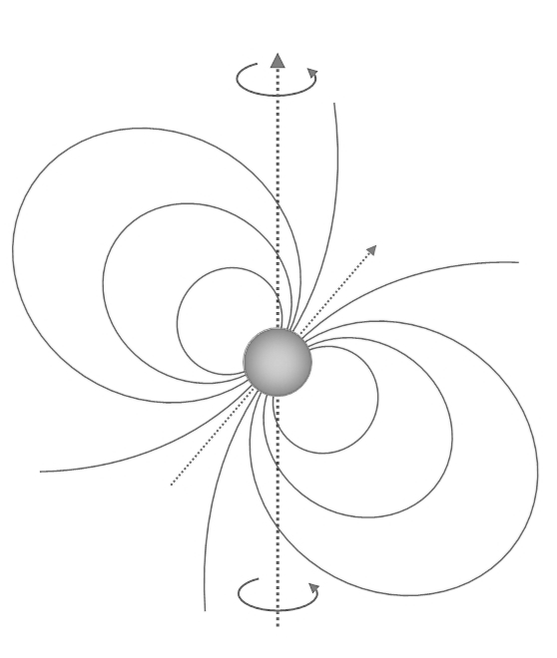
PSR J1023+0038
Adam Mendoza

Slide 2
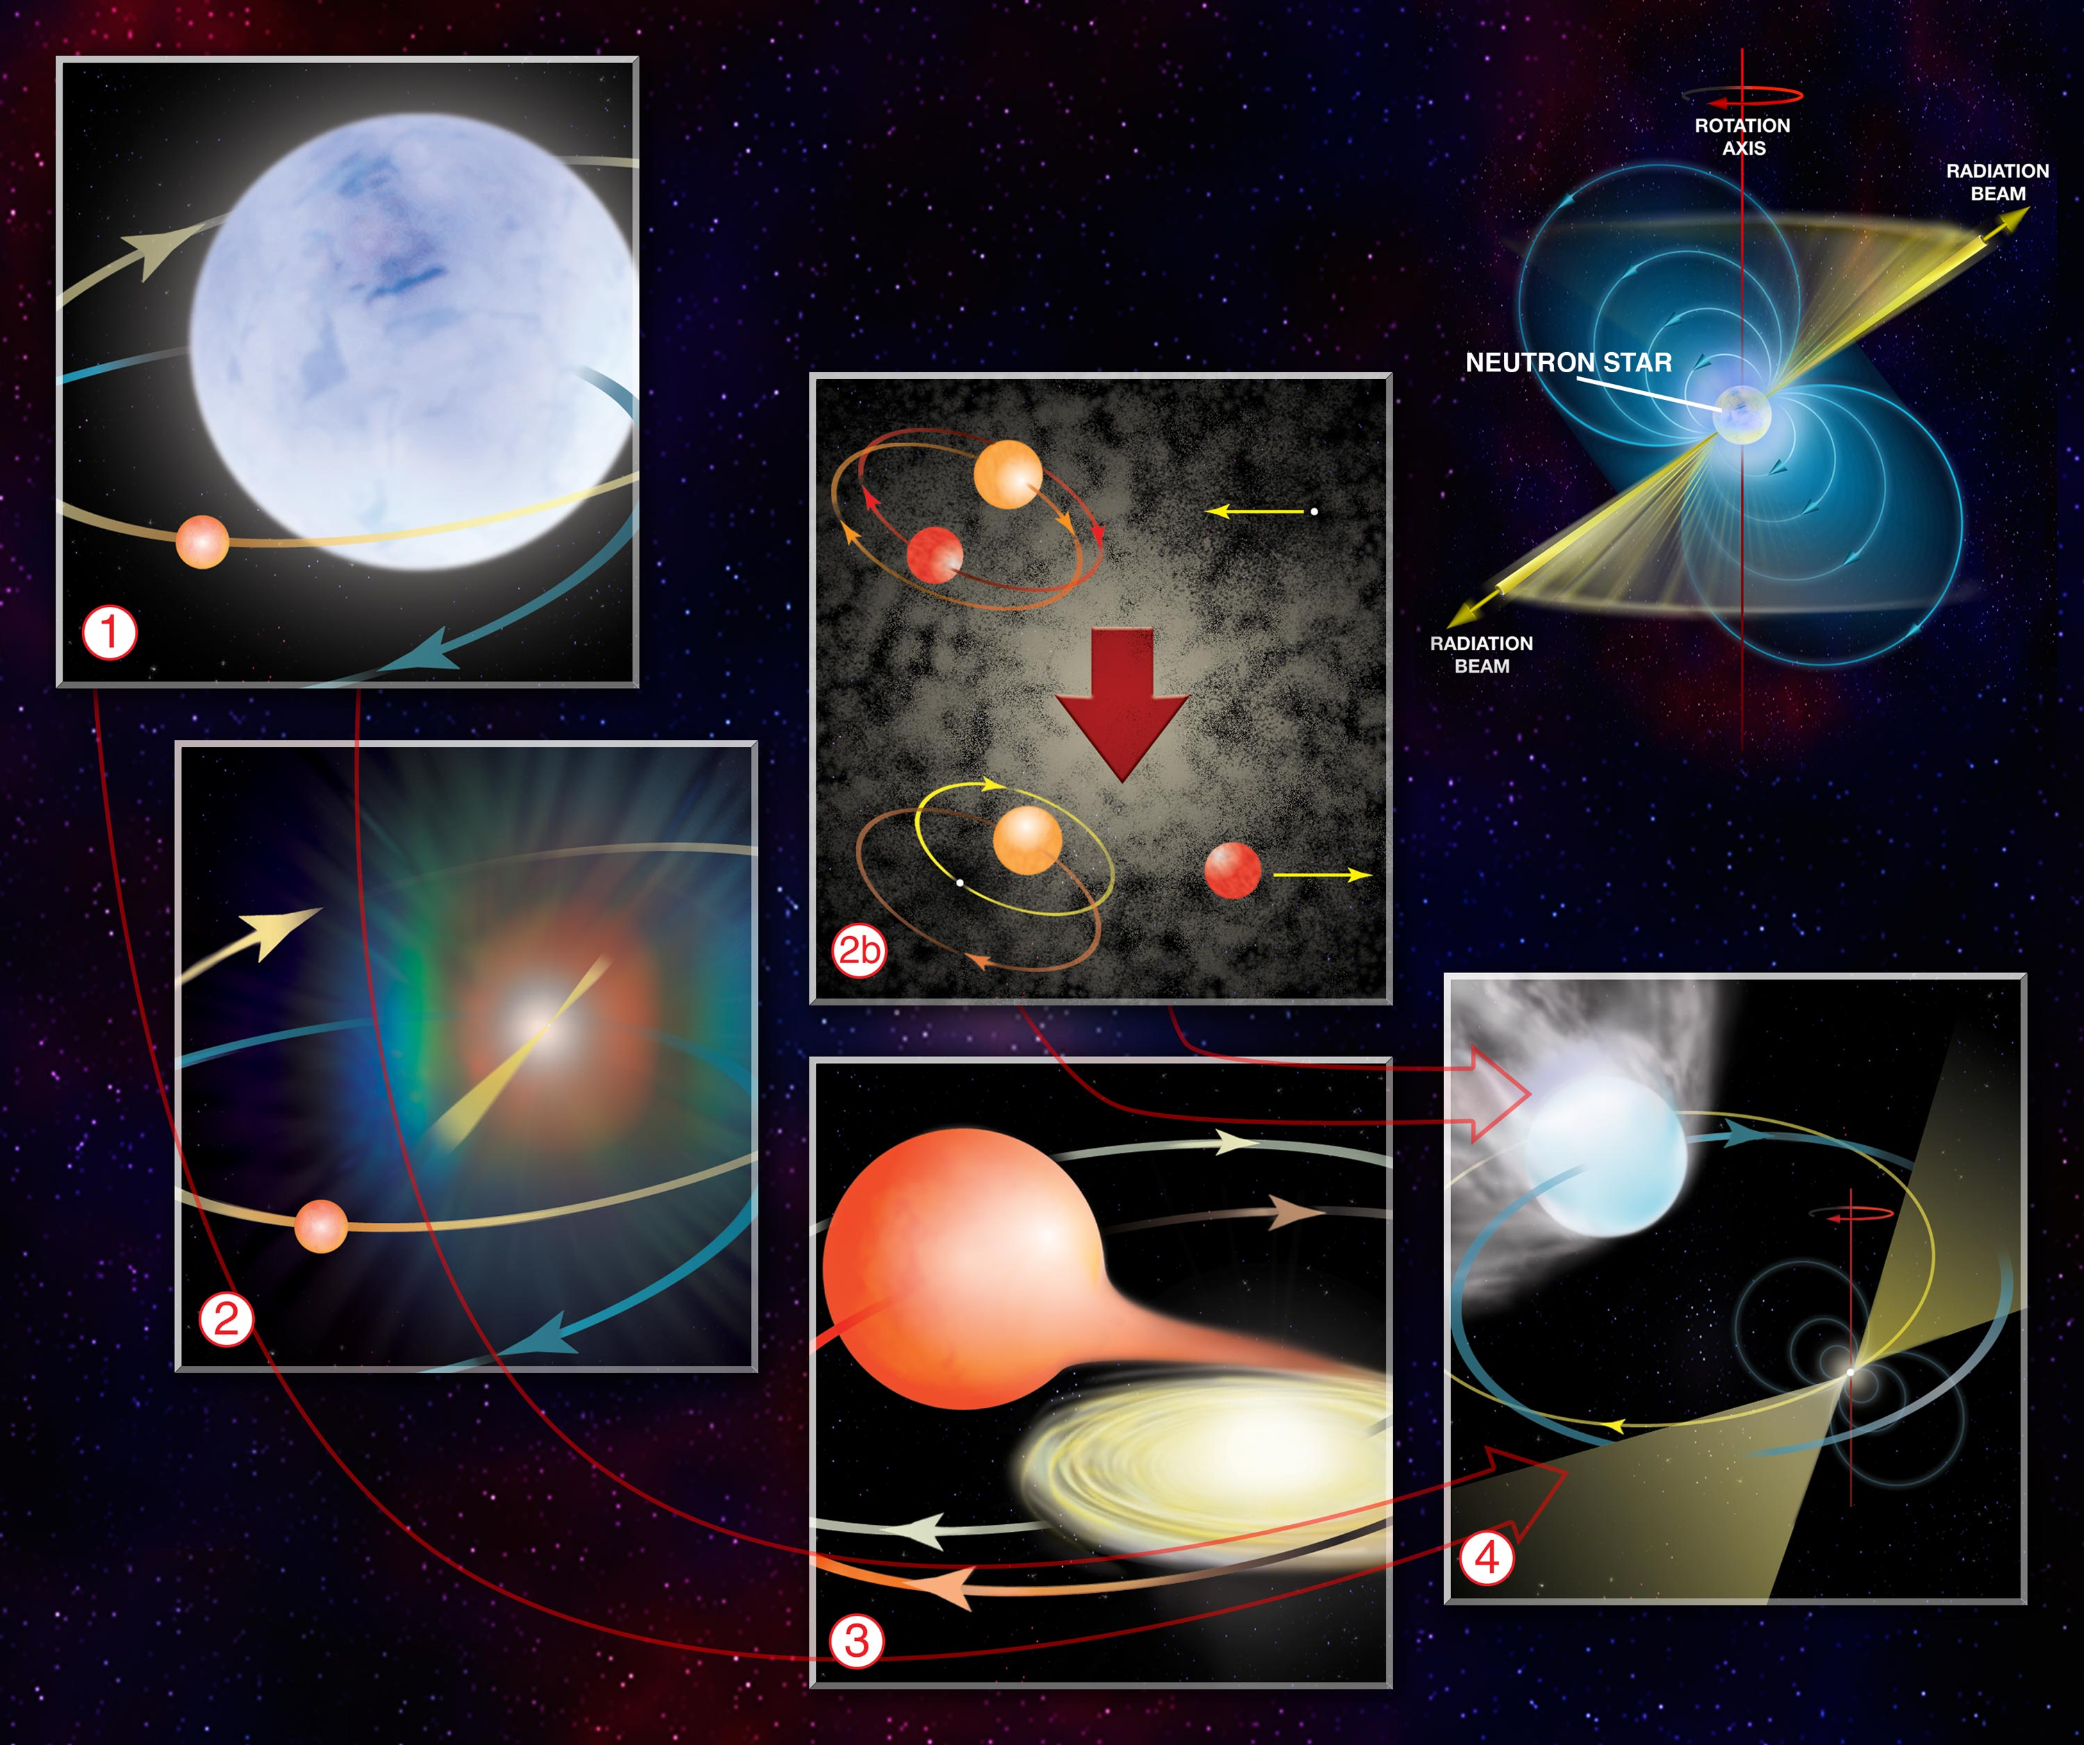
Standard Formation Scenario
Binary system where a star undergoes a supernova.
Companion star swells at some point, allowing the remnant neutron star to accrete material from it for a long period of time (low mass X-ray binary or LMXB).
Accretion increases neutron star rotation, allowing it to become a MSP at a long enough timescale.

Slide 3
PSR J1023+0038 is weird
J1023 was first detected with clear signs of an accretion disc. It was later on identified as a neutron star in a LMXB.
Observations in 2003-2005 revealed no presence of an accretion disc and was later classified as a radio MSP.
Since 2013, it settled in a LMXB state.
PSR J1023+0038 was classified as a transitional millisecond pulsar (tMSP)

Slide 4
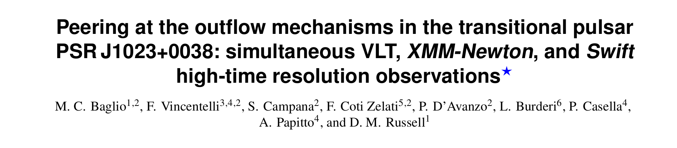
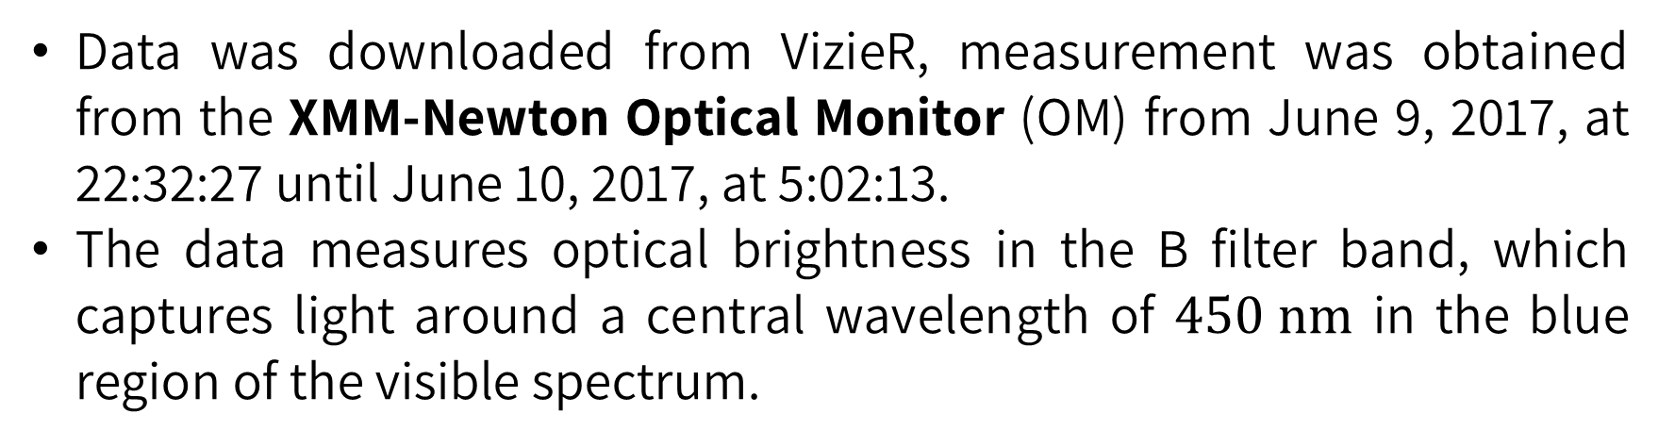
Dataset description
Data was downloaded from VizieR, measurement was obtained from the XMM-Newton Optical Monitor (OM) from June 9, 2017, at 22:32:27 until June 10, 2017, at 5:02:13.
The data measures optical brightness in the B filter band, which captures light around a central wavelength of $450 nm$ in the blue region of the visible spectrum.

Slide 5
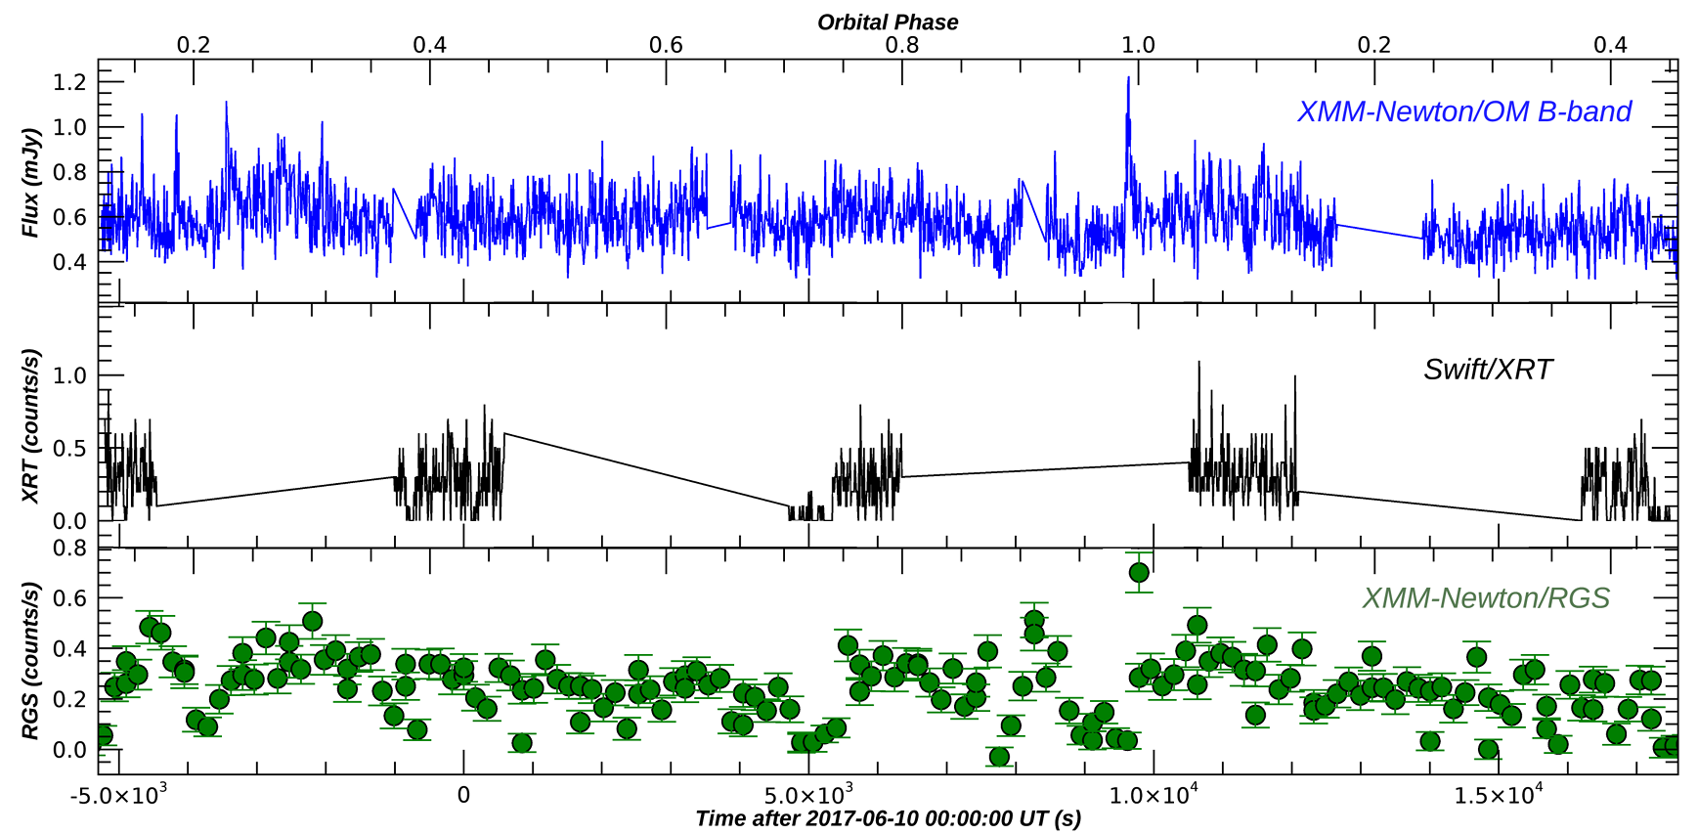
Light curves

Slide 6
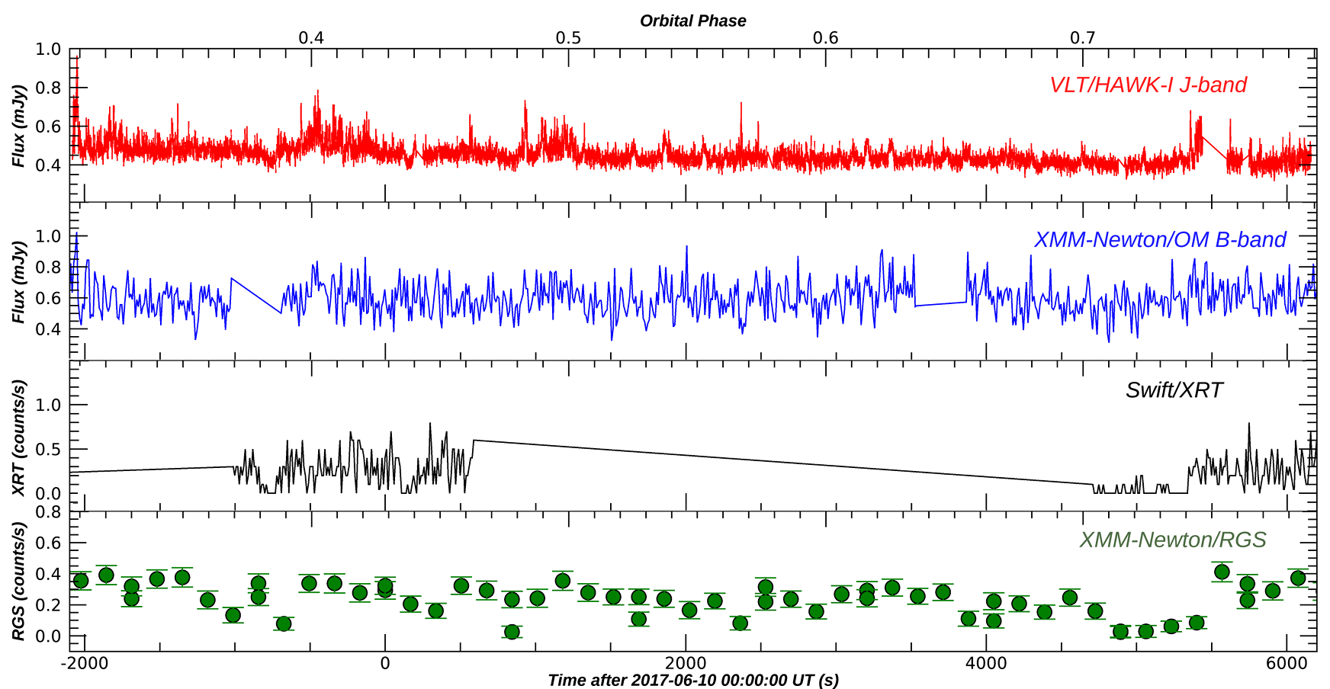
Light curves

Slide 7
Detrending process
We have used two detrending methods:
Regular moving average detrending with a window size of 50.
Fast Fourier Transform (FFT) detrending where the five highest frequency values are set to 0.

Slide 8
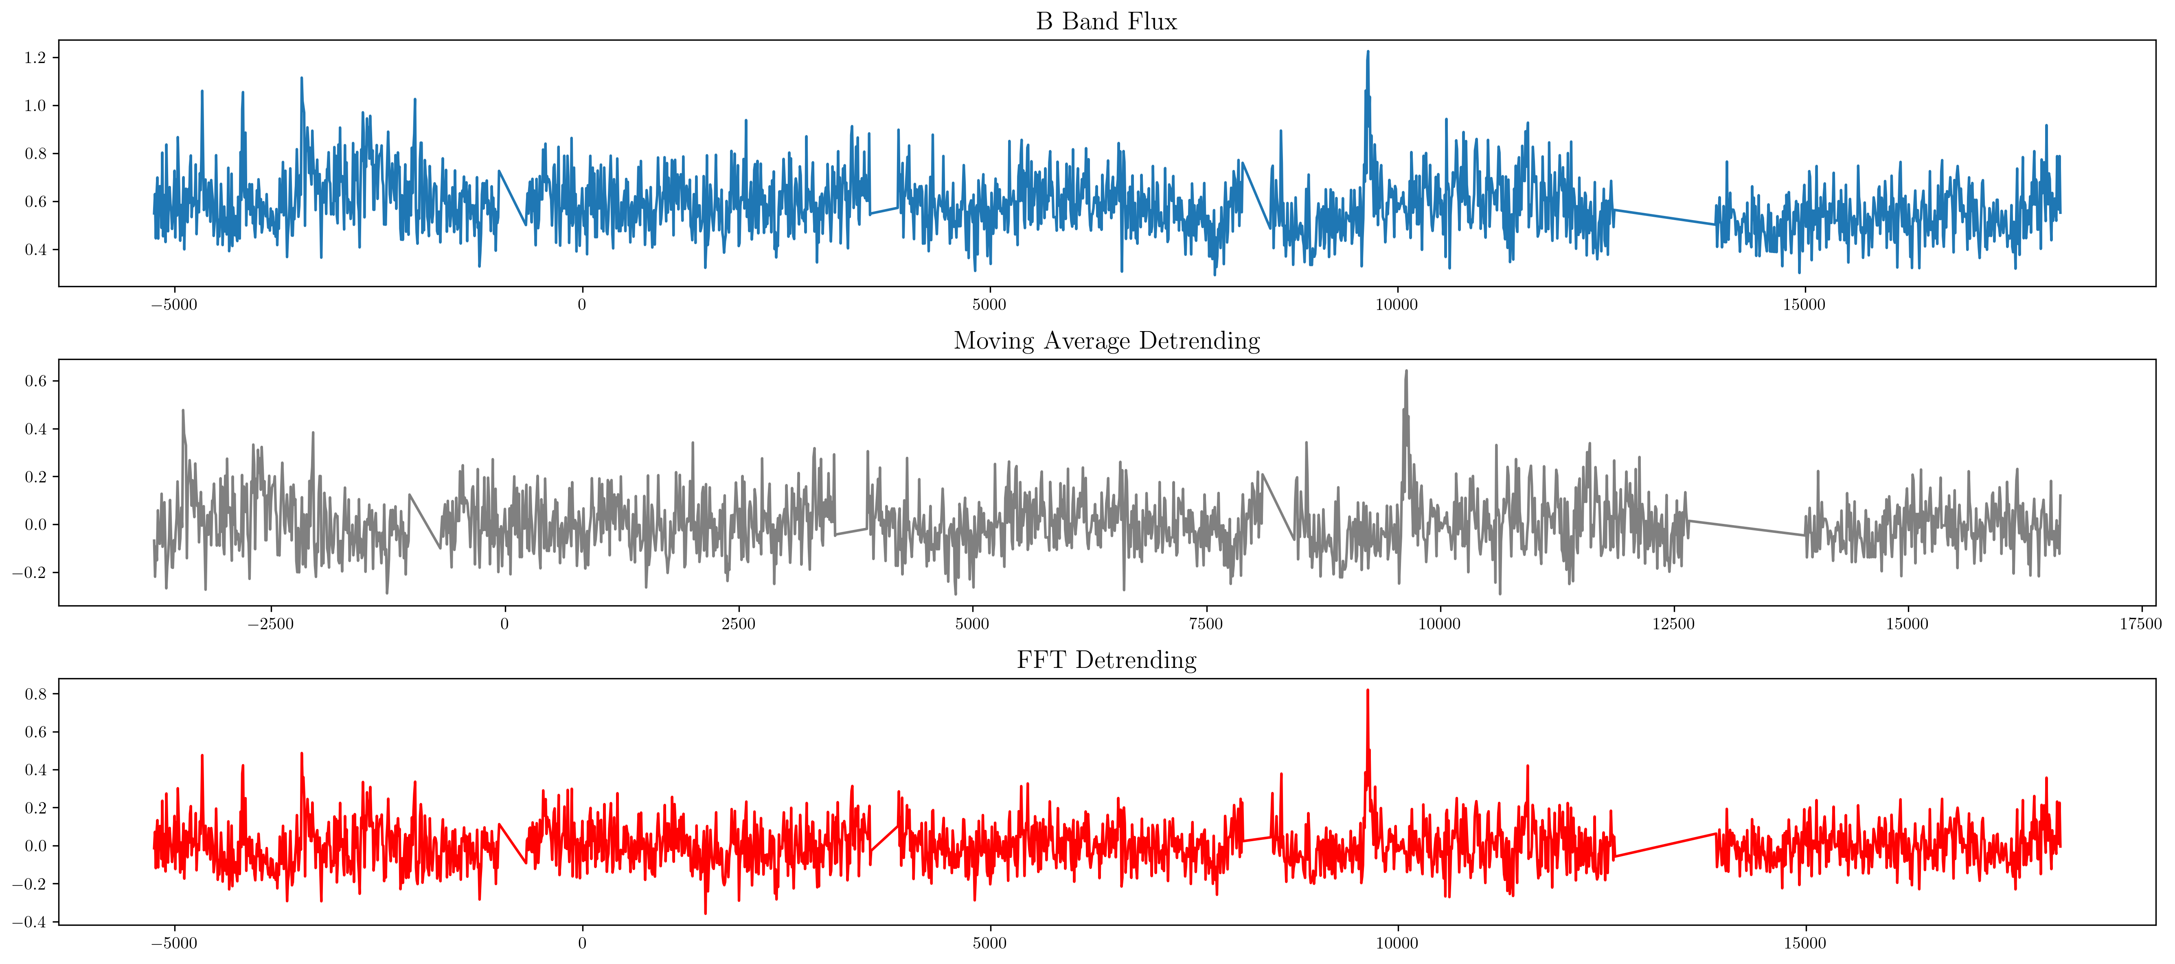
Detrending process

Slide 9
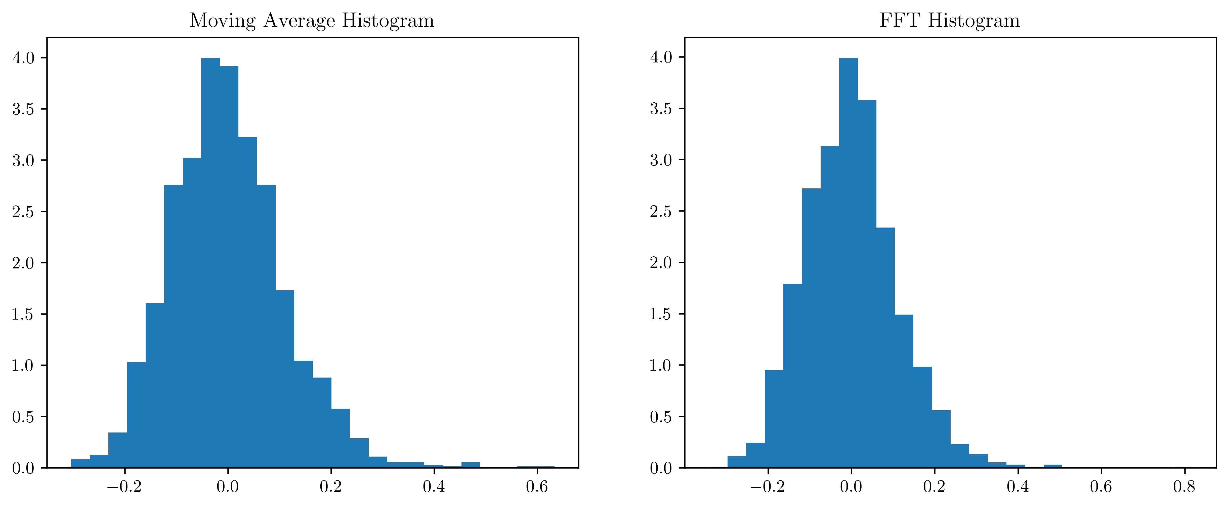
Probability Density Distribution

Slide 10
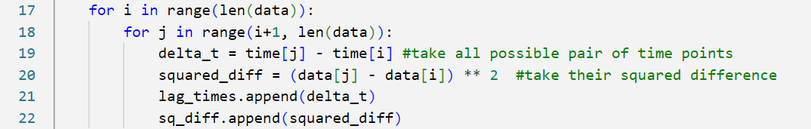
Getting the MSD
Calculate the time difference (lag time) and squared differences between all pairs of data points

Slide 11
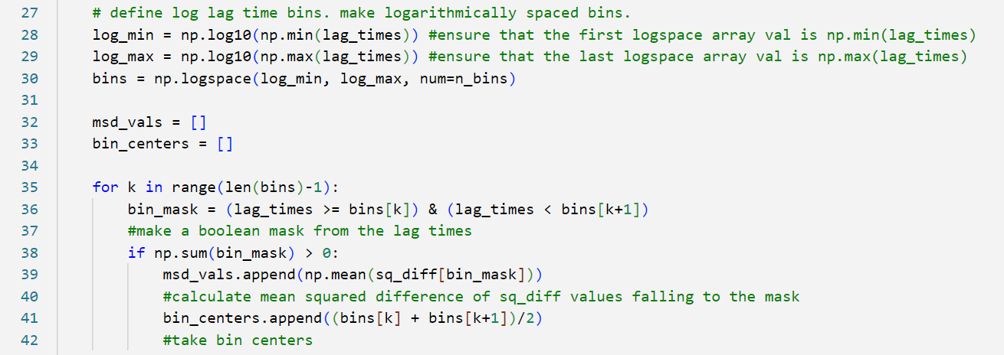
Getting the MSD
Create logarithmically spaced time bins, place the corresponding squared differences for each bin, and calculate the MSD.

Slide 12
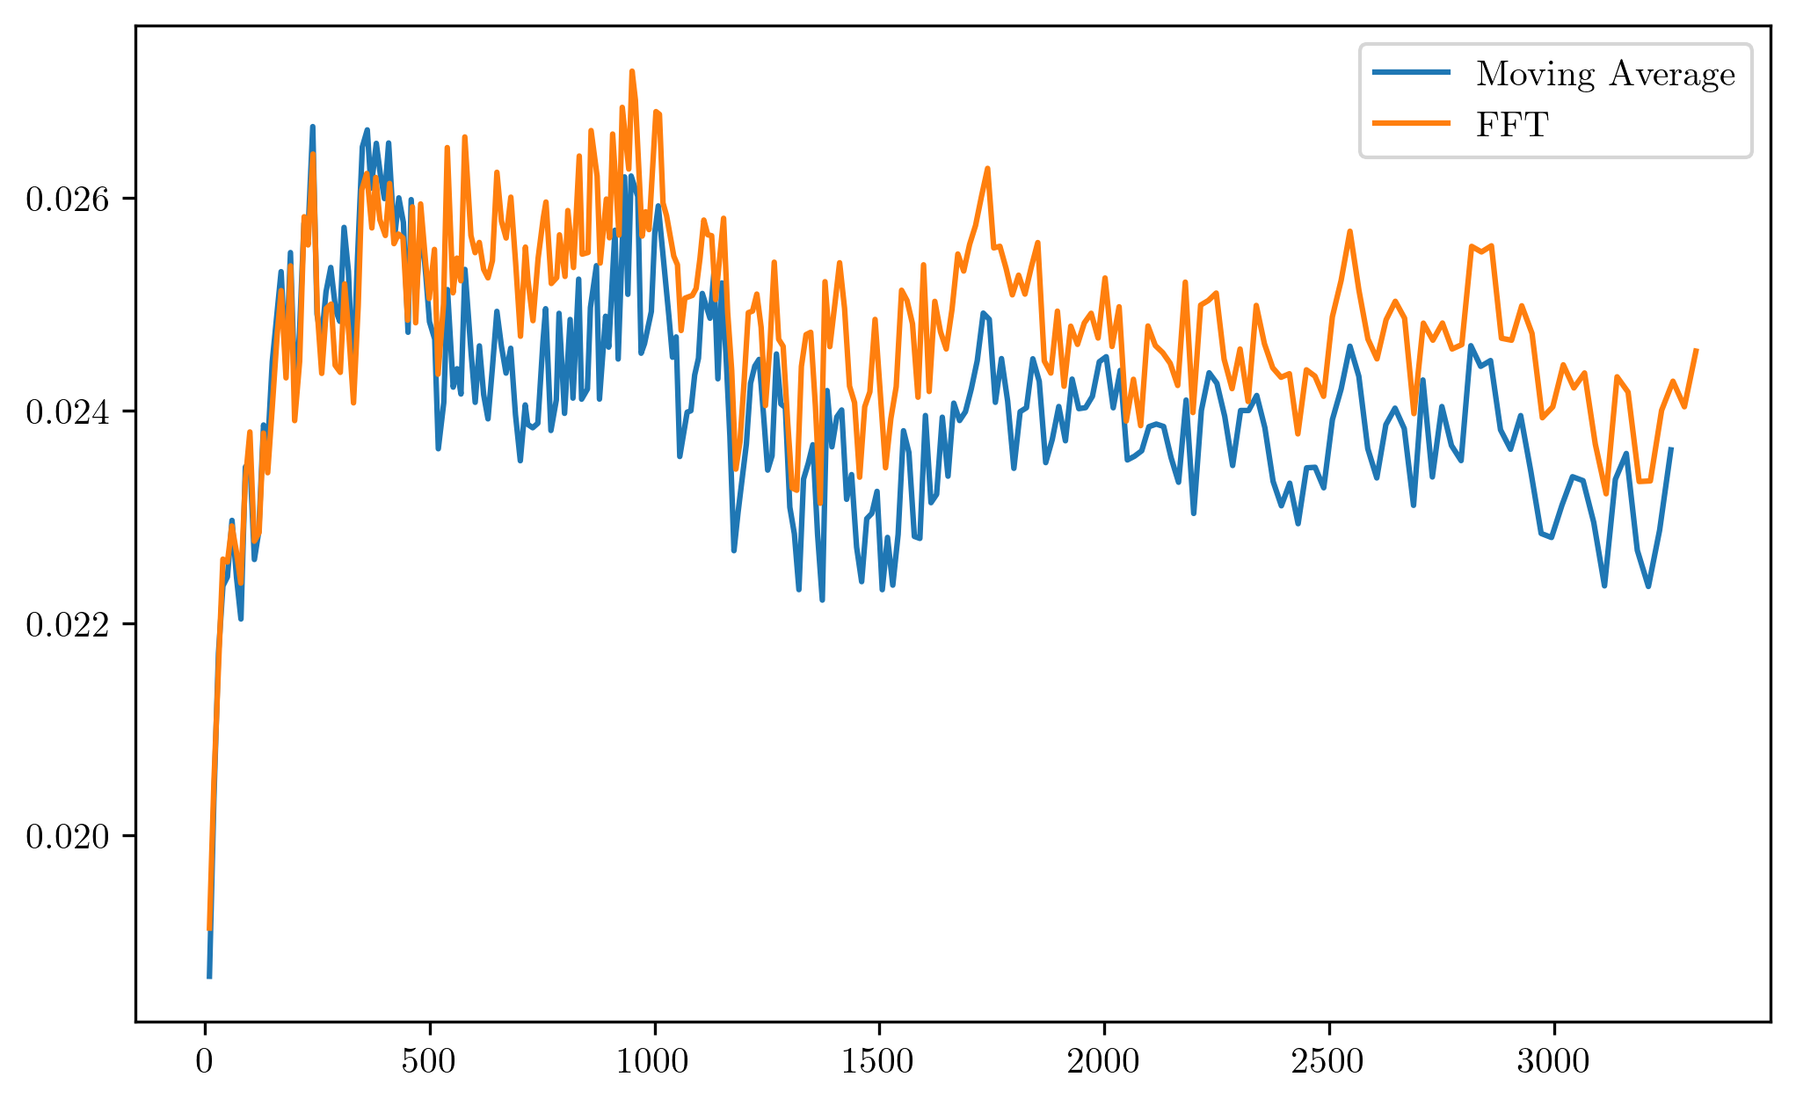
Getting the MSD

Slide 13
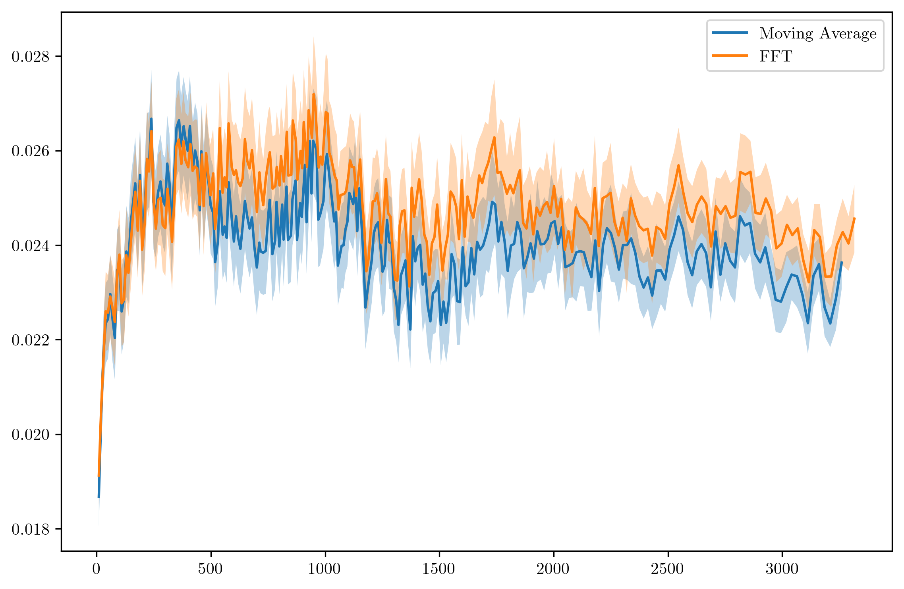
Getting the MSD

Slide 14
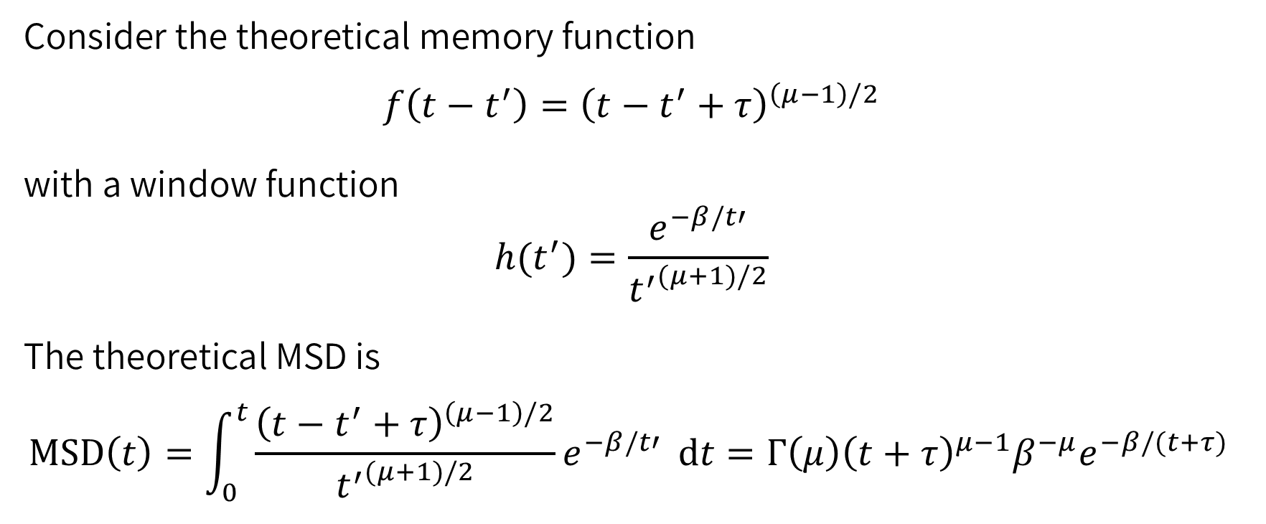
Theoretical MSD
Consider the theoretical memory function
$$f\left(t−t^{′}\right)={\left(t−t^{′}+τ\right)}^{\left(μ−1\right)/2}$$
with a window function
$$h(t^{′})=\frac{e^{−β/t′}}{{t^{′}}^{(μ+1)/2}}$$
The theoretical MSD is
$$MSD\left(t\right)=\int_{0}^{t}{\frac{{\left(t−t^{′}+τ\right)}^{\left(μ−1\right)/2}}{{t^{′}}^{(μ+1)/2}}e^{−β/t′}} dt=Γ\left(μ\right){\left(t+τ\right)}^{μ−1}β^{−μ}e^{−β/(t+τ) }$$

Slide 15
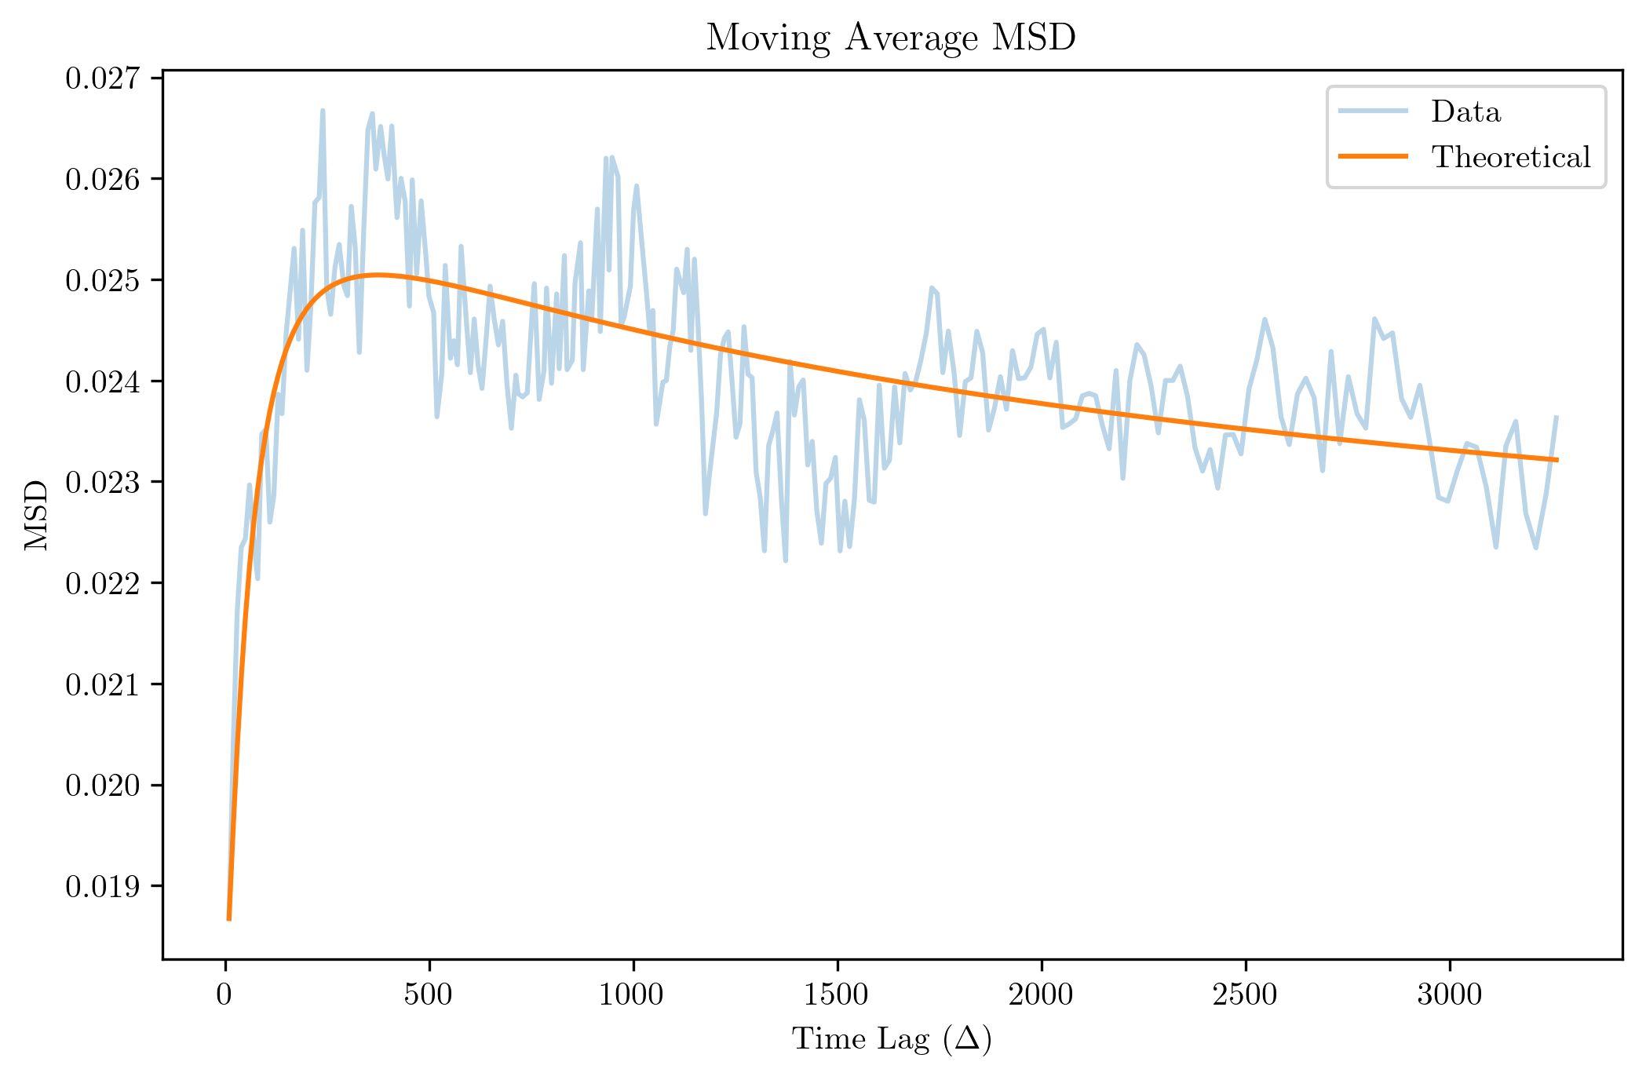
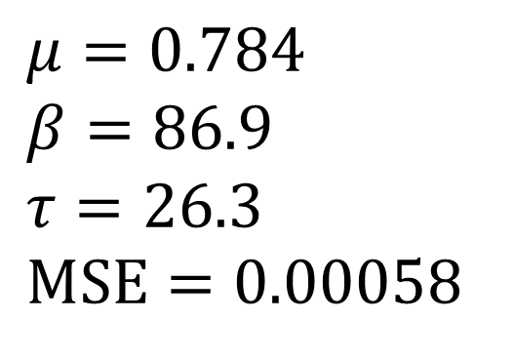
MSD Fitting (Moving Average)
$$μ=0.784 \\ β=86.9 \\ τ=26.3 \\ MSE=0.00058$$

Slide 16
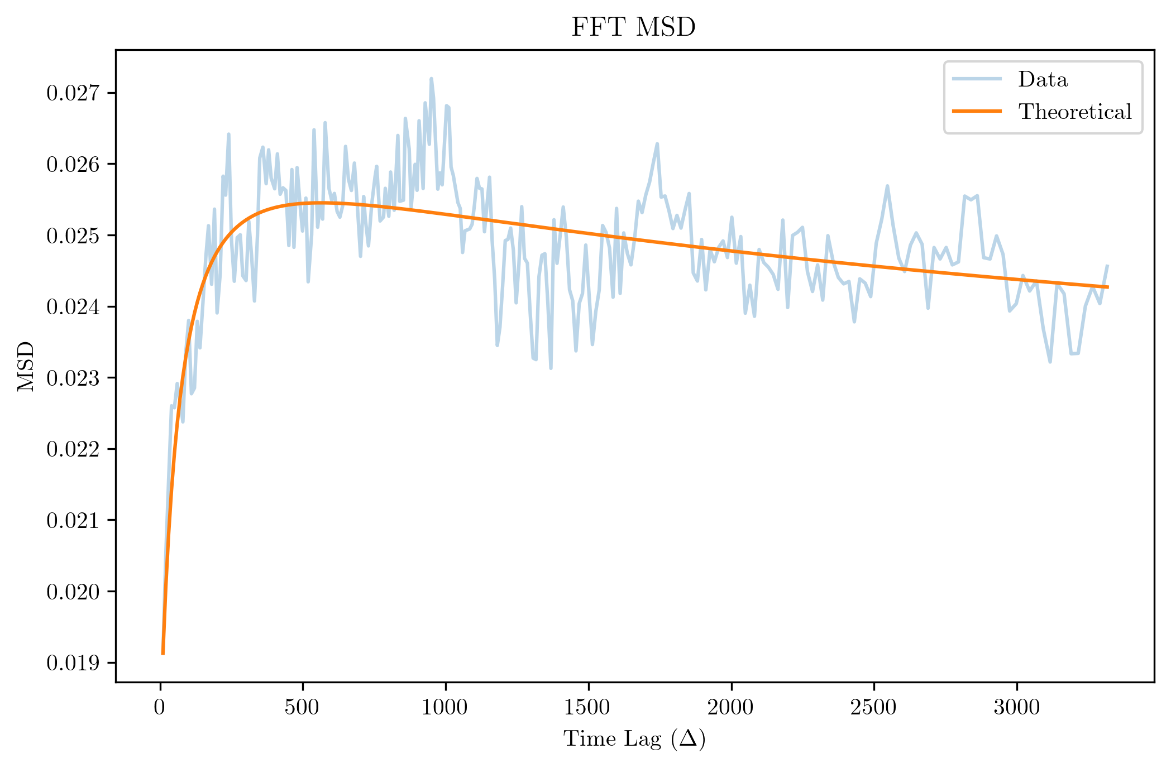
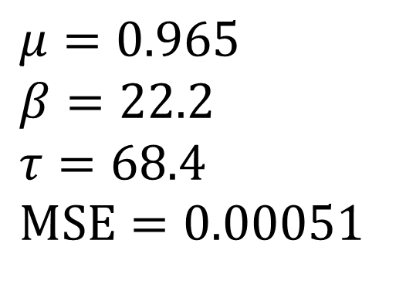
MSD Fitting (FFT)
$$μ=0.965 \\ β=22.2 \\ τ=68.4 \\ MSE=0.00051$$

Slide 17
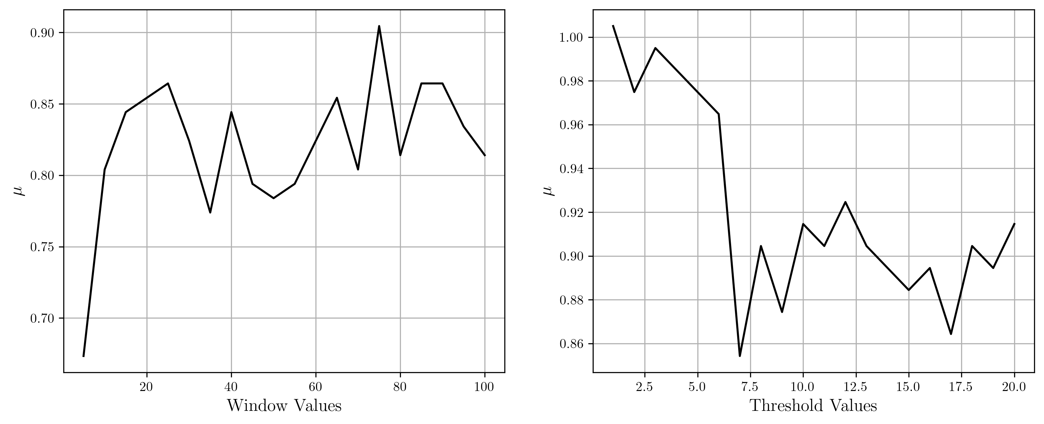

Detrending strictness and $μ$

Slide 18
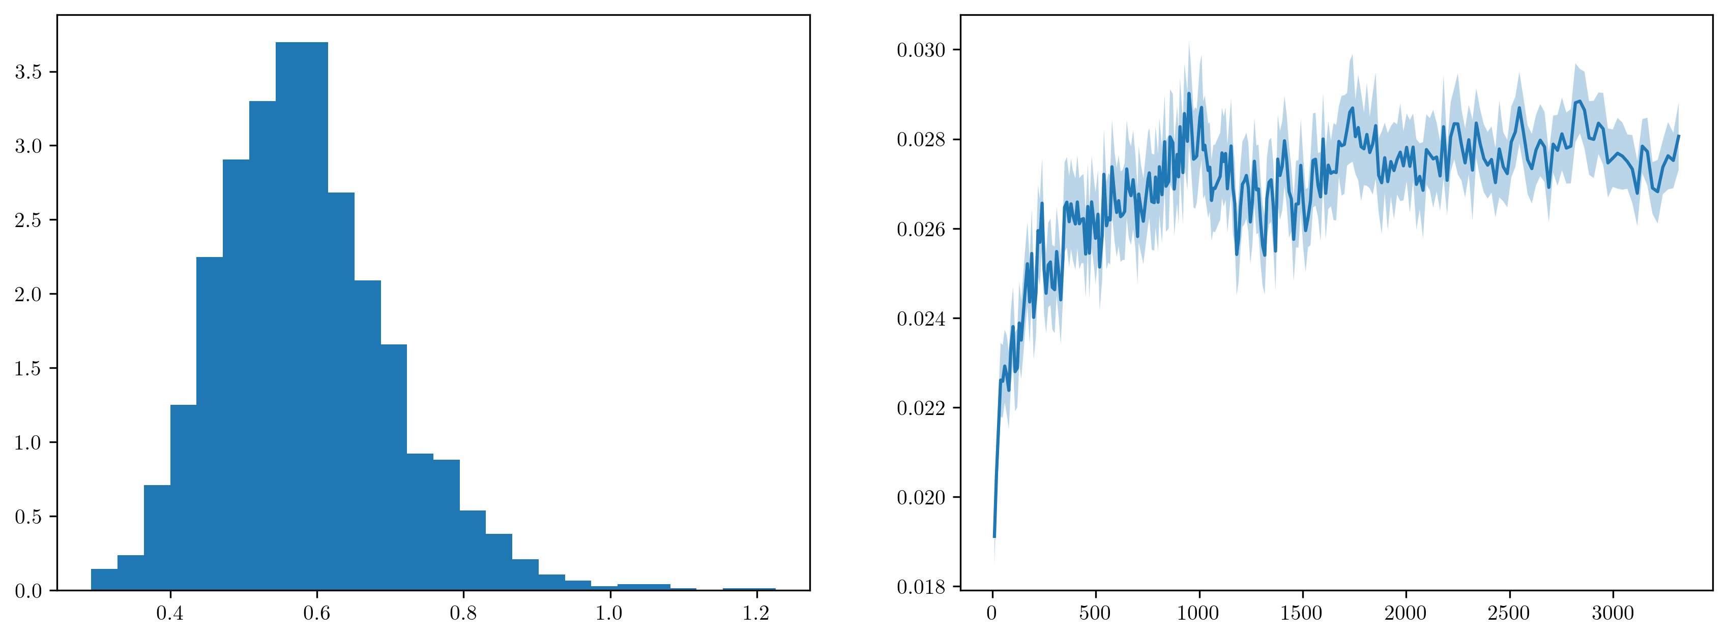
Raw data

Slide 19
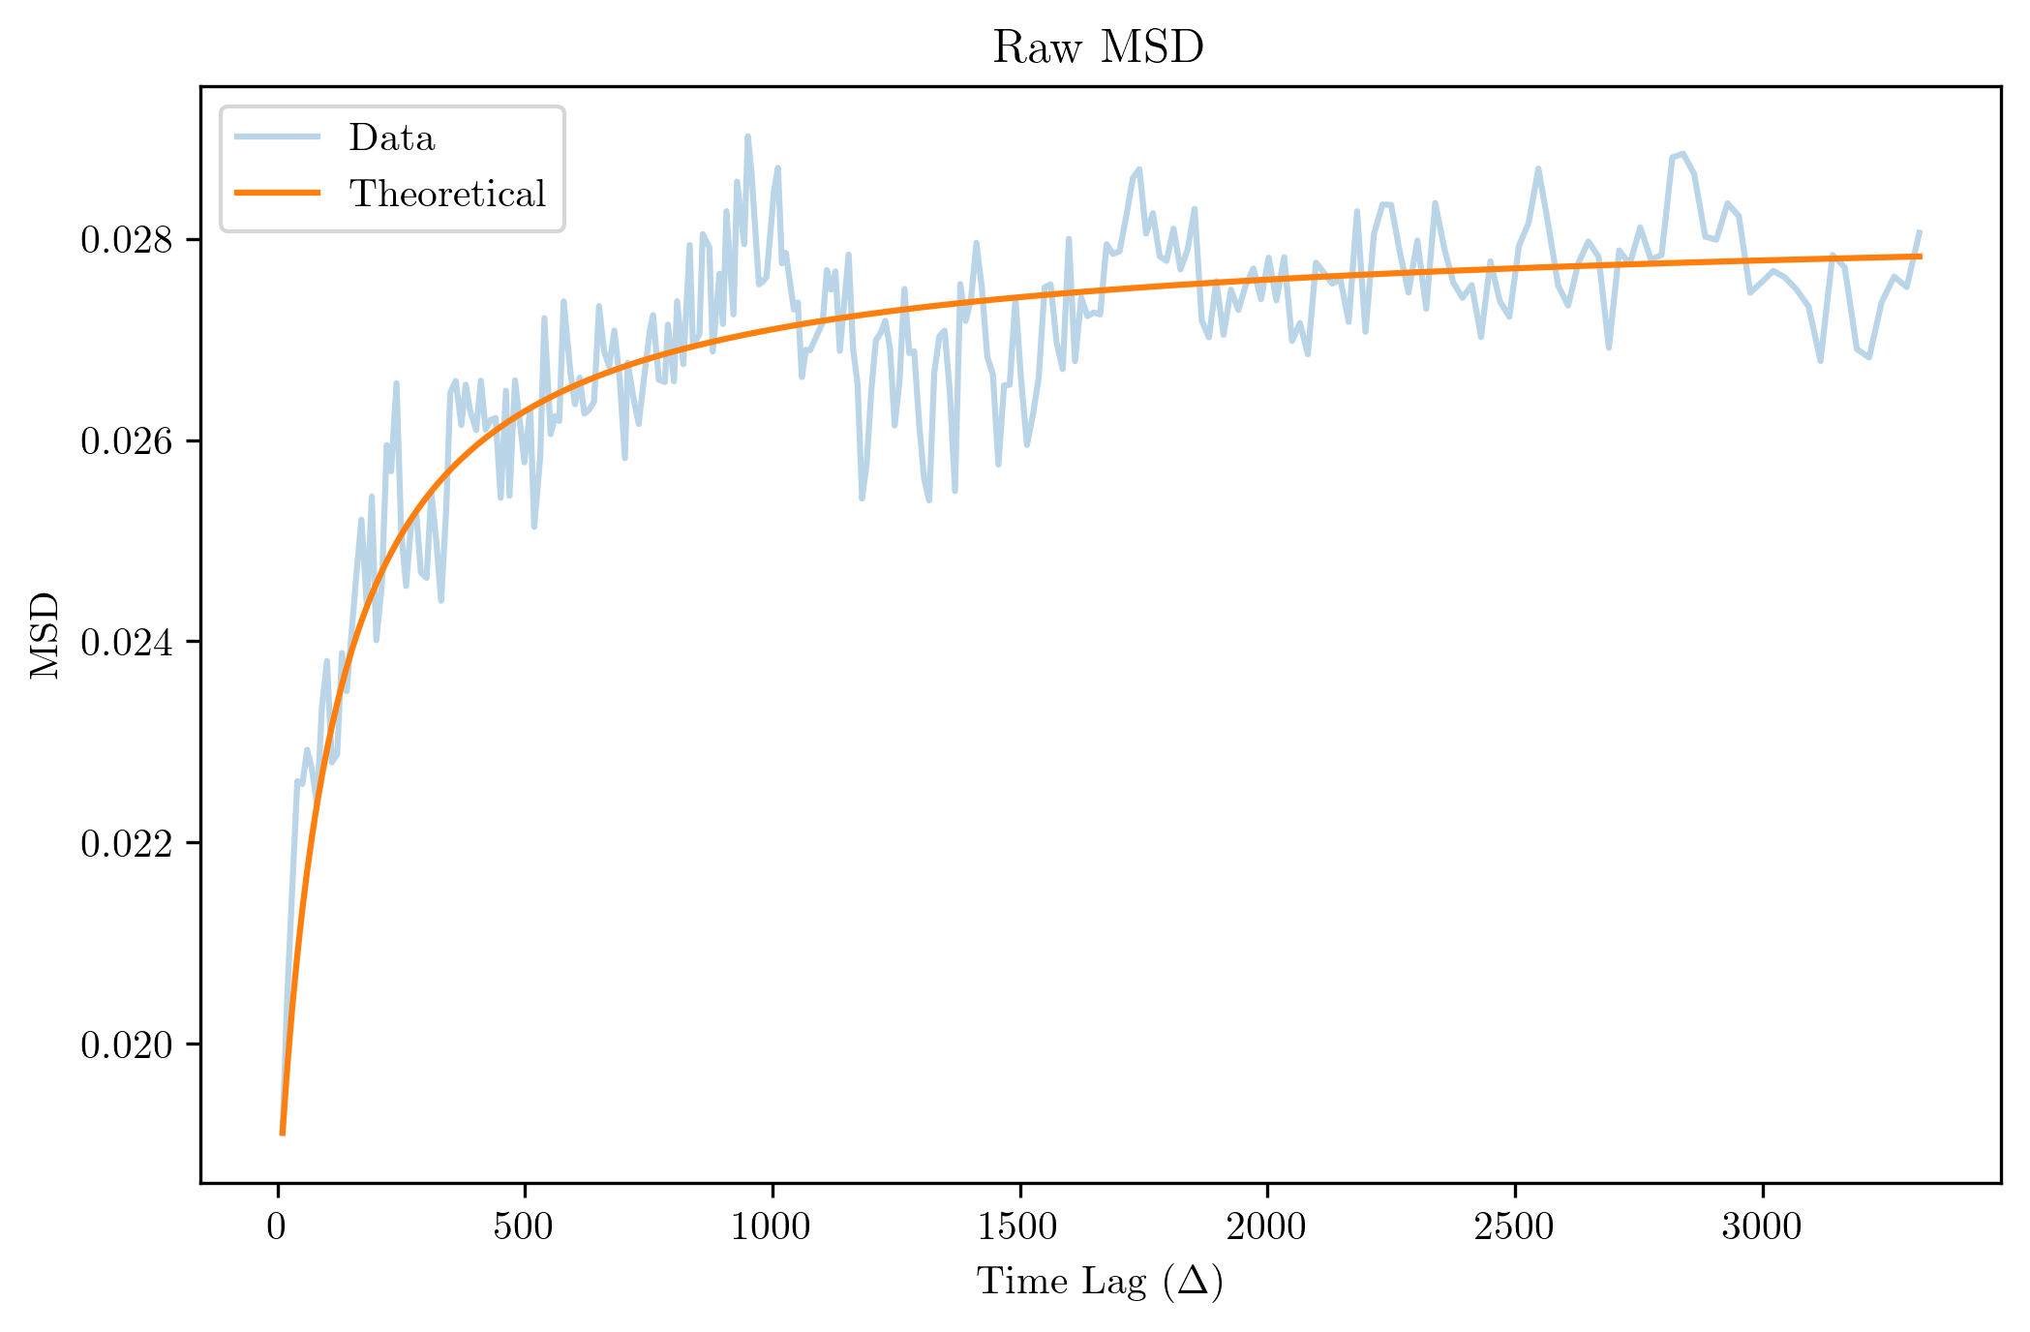
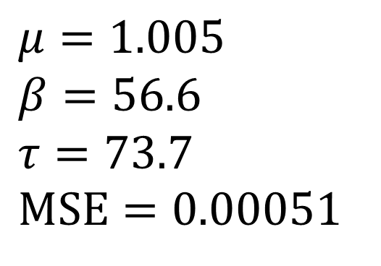
Raw data
$$μ=1.005 \\ β=56.6 \\ τ=73.7 \\ MSE=0.00051$$

Slide 20
End

